Slide 1

Anomalous Login Detection using ELK
(P06)
Aaffan Khan Niazi
Mustafa Hussain
Mohammad Mustafa
Shehroz faryad
Notes:
This class diagram outlines the core structural components of the Anomalous Login Detection System. Each class encapsulates a key part of the system’s functionality, focusing on real-time detection and visualization of abnormal login behavior.
At the center is the `LogEvent` class, which standardizes incoming authentication data from various sources and feeds it into the detection pipeline. The `UserProfile` class maintains contextual baselines—such as usual login hours or devices—to distinguish normal activity from threats.
Detection rules, encapsulated in the `DetectionRule` class, evaluate each event for predefined anomalies. When an anomaly is found, an `Alert` is created, structured with severity and context. The `Dashboard` class serves as the visual layer, allowing analysts and admins to track, review, and respond to potential incidents in real time.

Slide 2

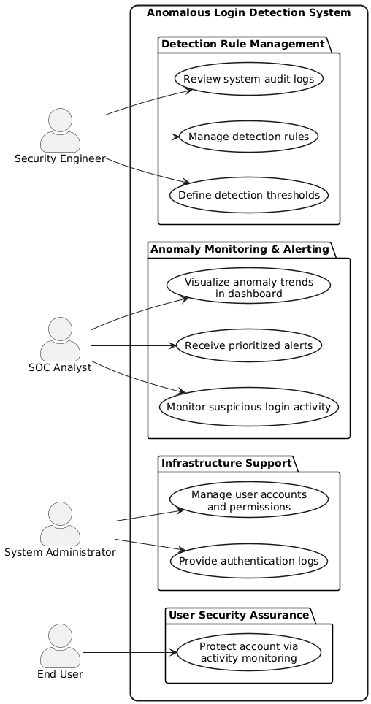
U
S
E
C
A
S
E
D
I
A
G
R
A
M
Notes:
This class diagram outlines the core structural components of the Anomalous Login Detection System. Each class encapsulates a key part of the system’s functionality, focusing on real-time detection and visualization of abnormal login behavior.
At the center is the `LogEvent` class, which standardizes incoming authentication data from various sources and feeds it into the detection pipeline. The `UserProfile` class maintains contextual baselines—such as usual login hours or devices—to distinguish normal activity from threats.
Detection rules, encapsulated in the `DetectionRule` class, evaluate each event for predefined anomalies. When an anomaly is found, an `Alert` is created, structured with severity and context. The `Dashboard` class serves as the visual layer, allowing analysts and admins to track, review, and respond to potential incidents in real time.

Slide 3
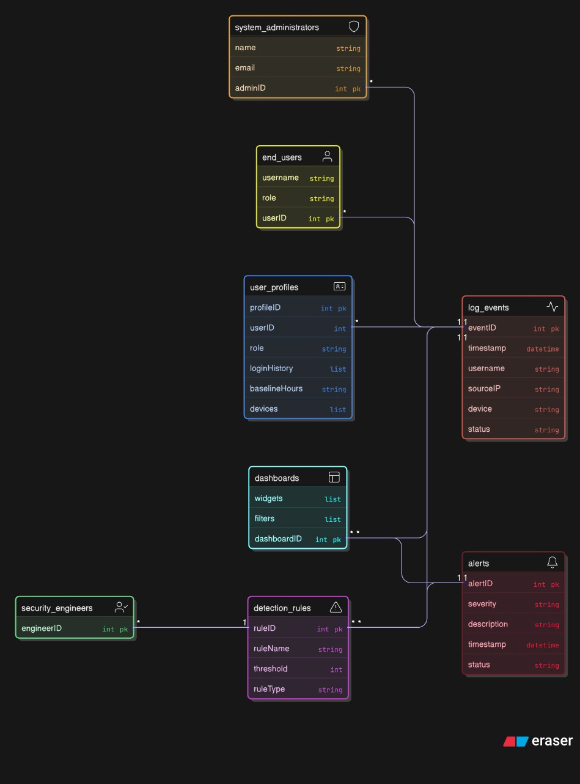
C
L
A
S
S
D
I
A
G
R
A
M
Notes:
This slide presents the system use case diagram for the Anomalous Login Detection System. The diagram maps out the interactions between system actors and the components built on the ELK stack. Starting from the end user, who generates authentication activity, the data is ingested via agents like Wazuh or Filebeat and passed on to Logstash for parsing. Security engineers play a pivotal role by defining detection rules that power the system’s intelligence.
Once the data is parsed, it’s stored in Elasticsearch where detection rules analyze it for patterns like brute-force attempts or impossible travel. Alerts are then visualized in Kibana for SOC analysts to review and respond to. Each actor — from the user to the SOC — plays a key role in this automated threat detection pipeline.
The design not only ensures real-time detection of threats but also provides traceability and context for each login event, significantly reducing the response time and enabling proactive defense mechanisms.

Slide 4


Sequence Diagram – Windows Logon Ingestion
UC-001: Ingest Windows Logon Events via ELK
Log Generation at Endpoint:
- Windows endpoint creates authentication logs (Winlogon, NTLM, Kerberos).
Collection via Agent:
- Wazuh/Winlogbeat agent securely collects and forwards logs to Logstash.
Parsing & Enrichment:
- Logstash normalizes data into Elastic Common Schema (ECS) and enriches with metadata.
Indexing in Elasticsearch:
- Events are stored in the auth-windows-* index for efficient search and analysis.
Visualization in Kibana:
- SOC analysts monitor authentication trends and detect threats through dashboards.
Notes:
This sequence diagram outlines the ingestion flow of Windows logon events, which is a critical component of the system. It begins at the endpoint where authentication activity is logged, such as a user logging into a workstation using NTLM or Kerberos protocols.
The Wazuh or Winlogbeat agent installed on that machine captures these events and securely transmits them to Logstash. Once received, Logstash parses the data and enriches it according to the Elastic Common Schema to ensure consistency and compatibility for indexing.
Next, the normalized data is stored in Elasticsearch under the `auth-windows-*` index. Finally, this data becomes accessible to SOC analysts through Kibana dashboards, enabling proactive review of login activity and detection of anomalies. This pipeline showcases how log ingestion is automated, secure, and tightly integrated with the ELK stack.

Slide 5

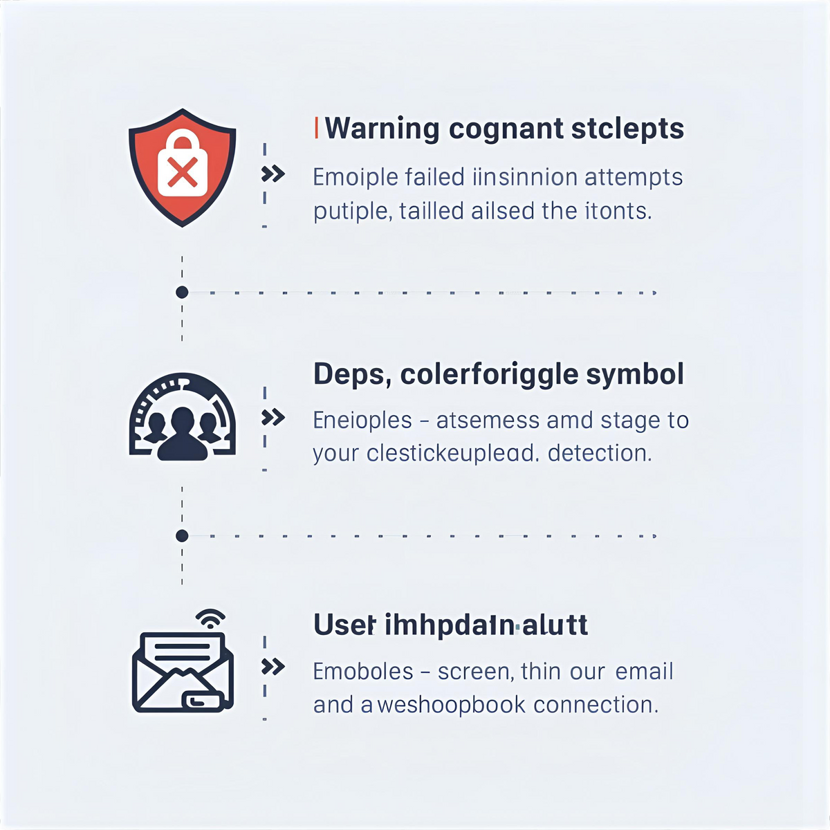
Sequence Diagram – Brute Force Attempts
UC-003: Detect Brute Force Attempts
Event Correlation:
Monitors multiple failed login events within a defined rolling time window.
Threshold-Based Detection
Generates an alert when failed login attempts exceed the configured threshold.
Alerting & Response
Alerts are displayed in Kibana and automatically trigger webhook or email notifications.
Notes:
This sequence diagram shows the ingestion of Linux SSH authentication logs — a foundational use case of the anomaly detection system. The process begins with a user initiating an SSH login to a Linux host. This action generates an authentication entry in the system log file, typically located at `/var/log/auth.log`.
A Filebeat or Wazuh agent installed on the Linux machine monitors this log file and forwards new entries to Logstash. Logstash is responsible for parsing the raw data and enriching it with structured fields such as login status, IP address, and timestamp.
After enrichment, the logs are indexed into Elasticsearch, specifically into the `auth-linux-*` index. From there, Kibana makes the data visible to SOC analysts through dashboards that track login activity and help identify abnormal patterns. This pipeline exemplifies the core role of the ELK stack in providing scalable, cross-platform anomaly detection.

Slide 6

Data Requirements
Log Coverage, Quality, and Model Readiness
Diverse Authentication Sources: Data must include successful and failed logins from Windows, Linux, Mac, VPN, MFA, and SSO systems.
Suspicious & Edge Cases: Logs should cover brute force, off-hours, impossible travel, and login from blocked geographies.
Data Quality & Integrity: < 5% corrupted entries allowed; data must support timestamp accuracy and complete user-agent metadata.
Controlled Test Inputs: Use simulated attacks in test environments to validate detection rules and system robustness.
Future ML Integration: Planned training of anomaly detection models with 90% minimum accuracy, retrained periodically with fresh data.
Notes:
This slide addresses the data requirements essential for powering the anomalous login detection system. The data must come from a diverse array of platforms — including Windows, Linux, Mac, VPN, MFA, and SSO — to ensure comprehensive visibility. Both successful and failed login events are critical to training and evaluating the system.
Special emphasis is placed on capturing edge cases: from brute force attacks to off-hours logins and geographically implausible travel. These anomalous patterns represent the core detection capabilities of the system. To maintain detection reliability, the dataset must contain less than 5% corruption, include accurate timestamps, and complete metadata such as user-agent strings.
Additionally, the system will rely on controlled test data — simulated attacks — to verify that alerts are triggered as expected. Looking forward, the system anticipates integration with machine learning models trained on this data to improve detection over time and adapt to new threat vectors. This forward-looking strategy ensures both robustness and scalability.

